Slide 1
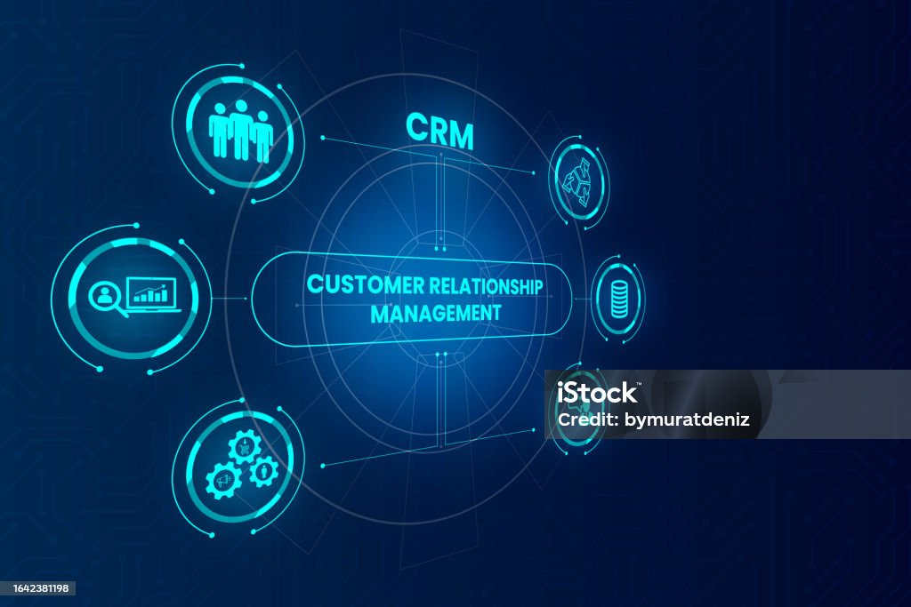
CUSTOMER RELATIONSHIP MANAGEMENT
Presented By:-Pratima Surve

Slide 2

INTRODUCTION
The CRM dataset contains organized data to analyze customer interactions and business performance. It includes information about customers, their interactions, sales leads, transactions, and support tickets. The dataset also comes with a metadata file that helps with understanding the data. With this information, businesses can track customer behavior, measure sales success, convert leads into customers, and address support issues. Overall, the dataset provides important insights that can help improve customer relationships and make better business decisions, enhancing strategies for sales, customer service, and marketing efforts.

Slide 3

ABOUT PROJECT
The CRM dataset includes customer demographics, sales, leads, support tickets, and interaction logs. It helps analyze customer behavior, sales performance, and service interactions, enabling businesses to track activity, improve customer satisfaction, and optimize marketing and sales strategies.

Slide 4
WHAT KINDS OF TABLES HAVE IN DATASET
1.Customers_large
Customer_id , first_name , last_name,
Email , phone, city , country , date_joined
2.Interactions_large
Interaction_id ,customer_id interaction_type, interaction_date , notes
3.Leads_large
Lead_id , customer_id lead_source
Lead_status , date_created
4.Sales_large
Sale_id , customer_id , product_id
Sale_date , amount
5.Tickets_large
Ticket_id , customer_id , issue_type
Status , date_created , date_resolved

Slide 5
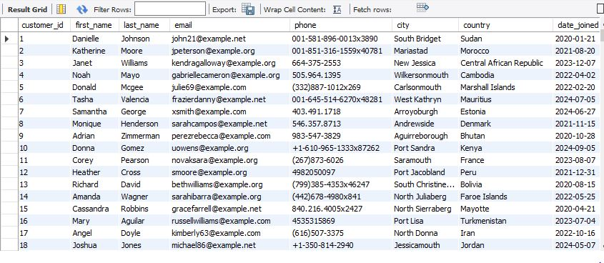
1.Customers_large

Slide 6
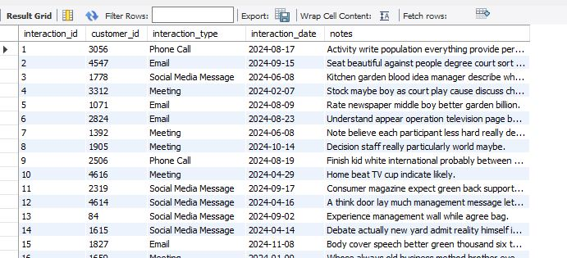
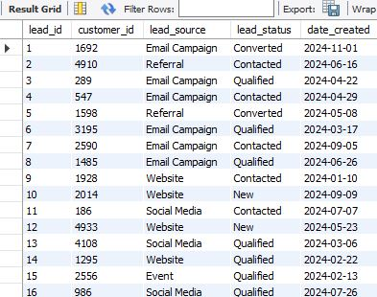
2.Interactions_large
3.Leads_large

Slide 7
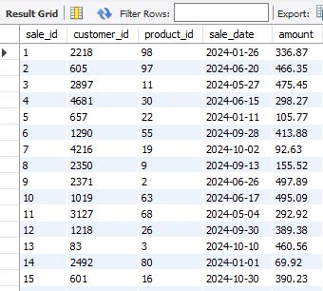
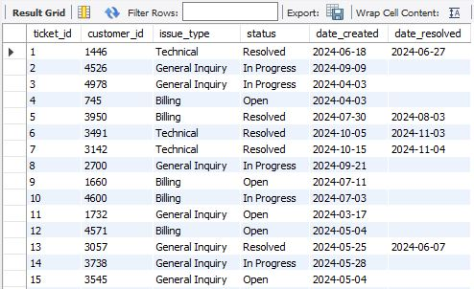
4.Sales_large
5.Tickets_large

Slide 8
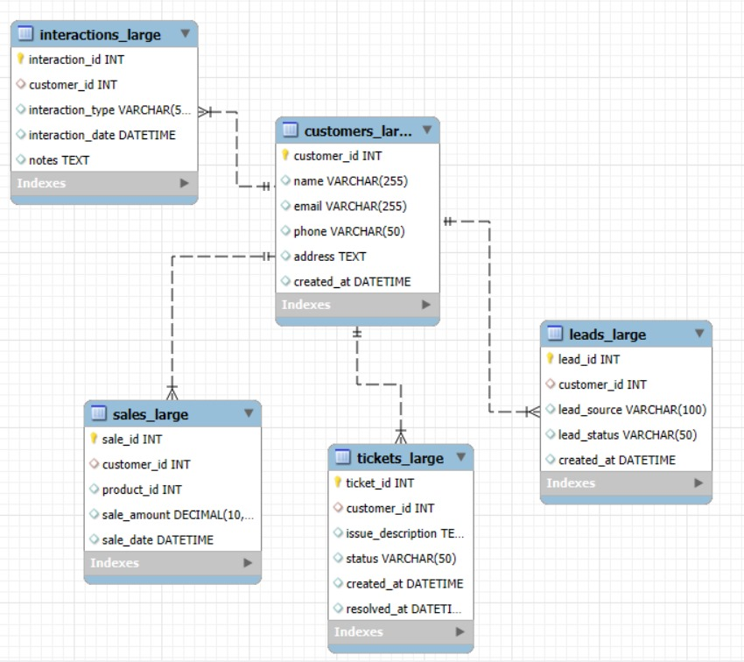
EER DIAGRAM

Slide 9
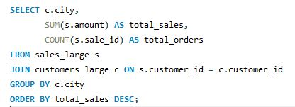
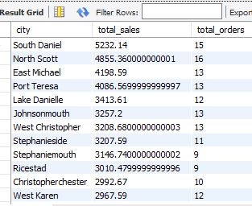
Problem Statement:-
1. Determine the total sales and the number of orders for each city.
Result:-
Conclusion:-
This query identifies cities with the highest sales and order volumes, helping focus on profitable locations.

Slide 10
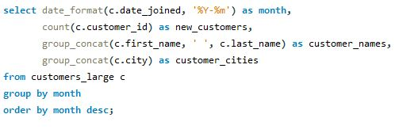
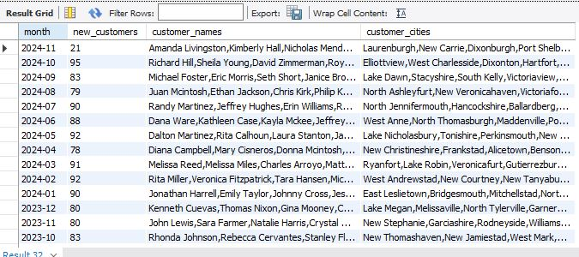
Problem Statement:-
2. track how many new customers joined each month and provide details such as customer first name and city
Result:-
Conclusion:-
this query finds how many new customers joined each month, lists their names and cities using the group_concat() function. this approach gives a clear view of customer growth and regional distribution.

Slide 11
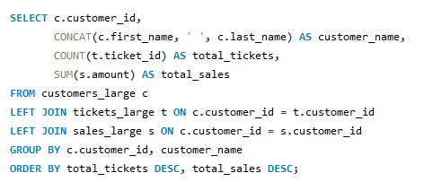
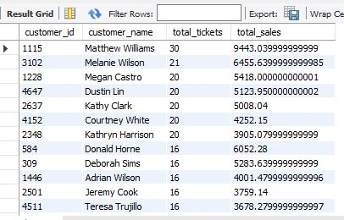
Problem Statement: 3. Identify customers with the highest number of tickets and their corresponding sales.
Result:-
Conclusion: Focuses on customers requiring frequent support but generating significant revenue.

Slide 12
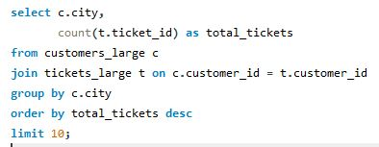
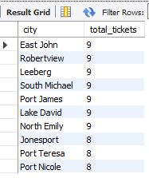
Problem Statement:-
4. identify the top 10 cities with the highest number of tickets raised.
Result:-
Conclusion:-this query identifies which cities have the highest number of tickets raised, which can help in allocating resources to those regions.

Slide 13
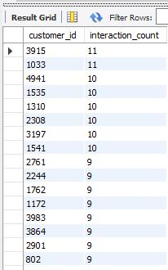
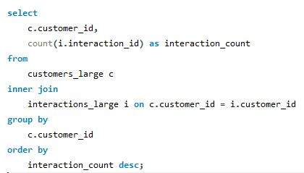
Problem Statement:
5.Identify How frequently do customers interact with the company?
Result:-
Conclusion:
High interaction counts indicate communication customers, suggesting that personalized marketing could enhance retention.

Slide 14
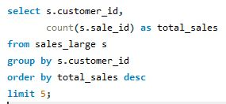
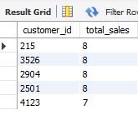
Problem Statement: 6. Identify the top 5 customers who have made the most purchases.
Result:-
Conclusion: This query identifies the top 5 customers who have made the most purchases, helping businesses target loyal customers for personalized offers and loyalty programs.

Slide 15
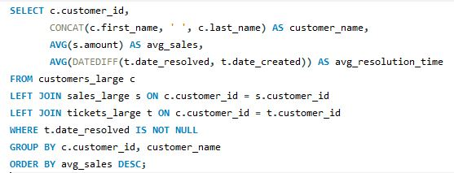
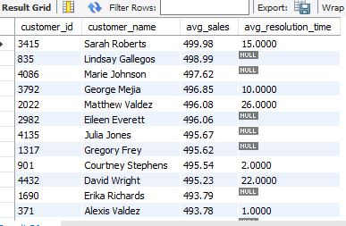
Problem Statement: 7. Analyze average sales and ticket resolution times for each customer.
Result:-
Conclusion: Helps identify if high-value customers face delays in issue resolution.

Slide 16
Problem Statement:- 8. Identify customers with the highest number of tickets and their corresponding sales.
Result:-
Conclusion:- Focuses on customers requiring frequent support but generating significant revenue.

Slide 17
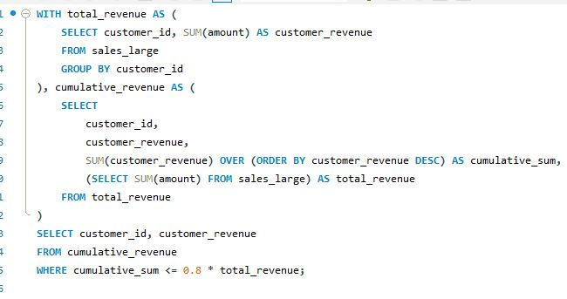
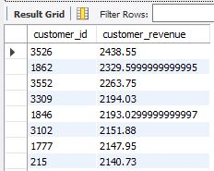
Problem Statement: 9.Which customers contribute to 80% of total revenue?
Result:-
Conclusion: Identifies key customers responsible for the majority of revenue.

Slide 18
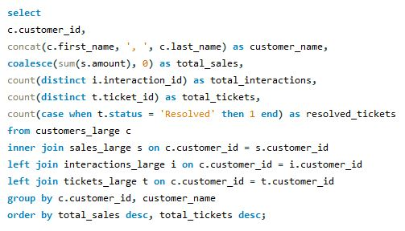
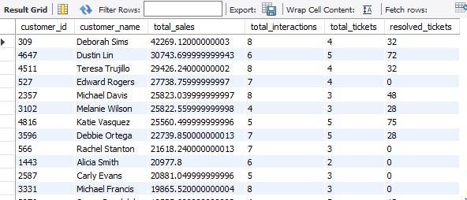
Problem Statement: 10. Analyze customer behavior by combining their sales, interactions, and ticket history into a unified report.
Result:-
Conclusion: High-value customers have high sales and communicate, while inactive customers show interactions or tickets but no recent sales.

Slide 19
CONCLUSION
The analysis identifies high-value customers through sales and engagement metrics, enabling personalized retention and upselling strategies. Inactive customers, who show interactions or support tickets but lack recent purchases, are highlighted for re-engagement opportunities. Cities and regions with high sales and engagement are pinpointed, guiding businesses to focus on profitable areas while addressing support delays. Lead source effectiveness and conversion rates are evaluated, optimizing marketing campaigns. Trends in customer interactions and behaviors are analyzed to align strategies with engagement patterns. By integrating data from sales, interactions, and tickets, unified reports provide a comprehensive view of customer activities and business performance.

Slide 20
THANK YOU

